Slide 1

Automated Feedback Analysis Workflow
Japheth Gordon
AI Automation | Project 3

Slide 2
Automated workflow using: Make
Thank you for joining us today. This presentation will:
Show the automation process using Make
Explain in detail the process and functions of that create the automation flow.
Project link. https://drive.google.com/file/d/1SA301H-QatYvb6ha_CsMcjbGtVZ__KVz/view?usp=sharing

Slide 3
Automation workflow: MAKE
Introduction to Make.com
What is Make.com?
A no-code automation platform enabling seamless connections between apps and services.
Key Features:
Visual Interface: Build automated workflows using an intuitive drag-and-drop approach.
Scenario Design: Create “scenarios” to automate data movement and actions between tools.
Automation Made Easy: Set specific triggers to initiate actions without the need for coding.

Slide 4
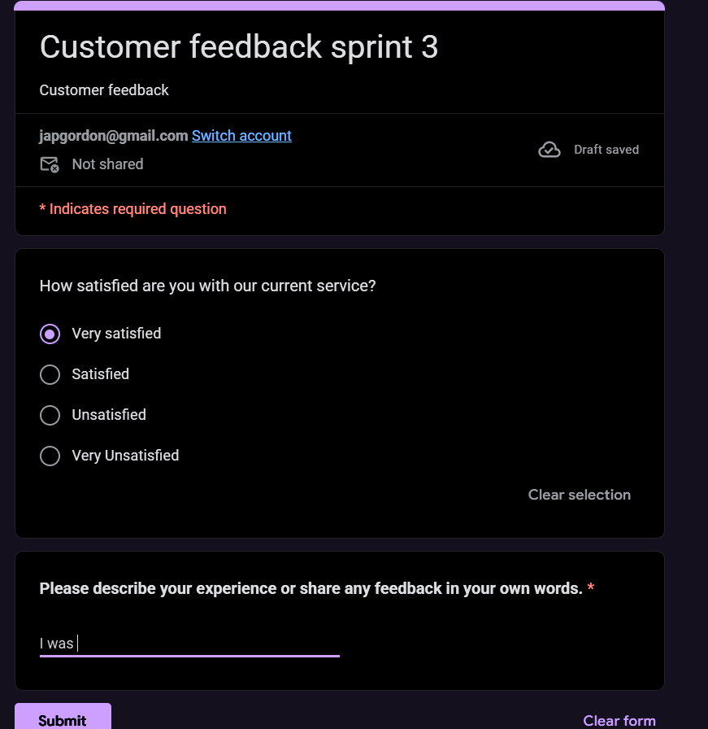
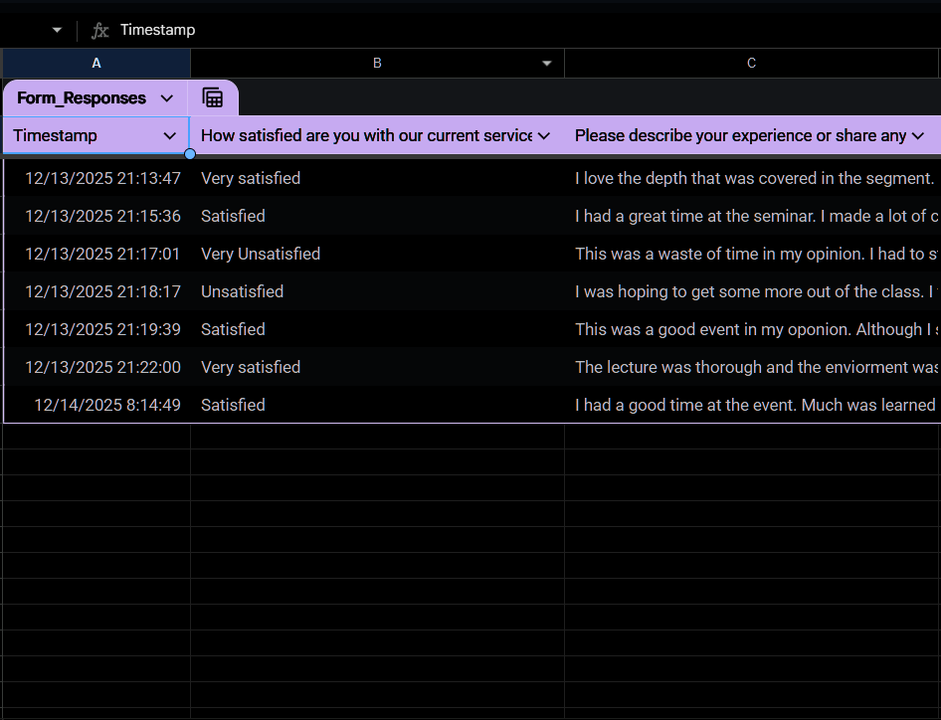
Workflow in action
Our workflow starts after customers submit their replies via Google forms. These answers will also be loaded on Google sheets to start the organization process. Then the fun begins.

Slide 5
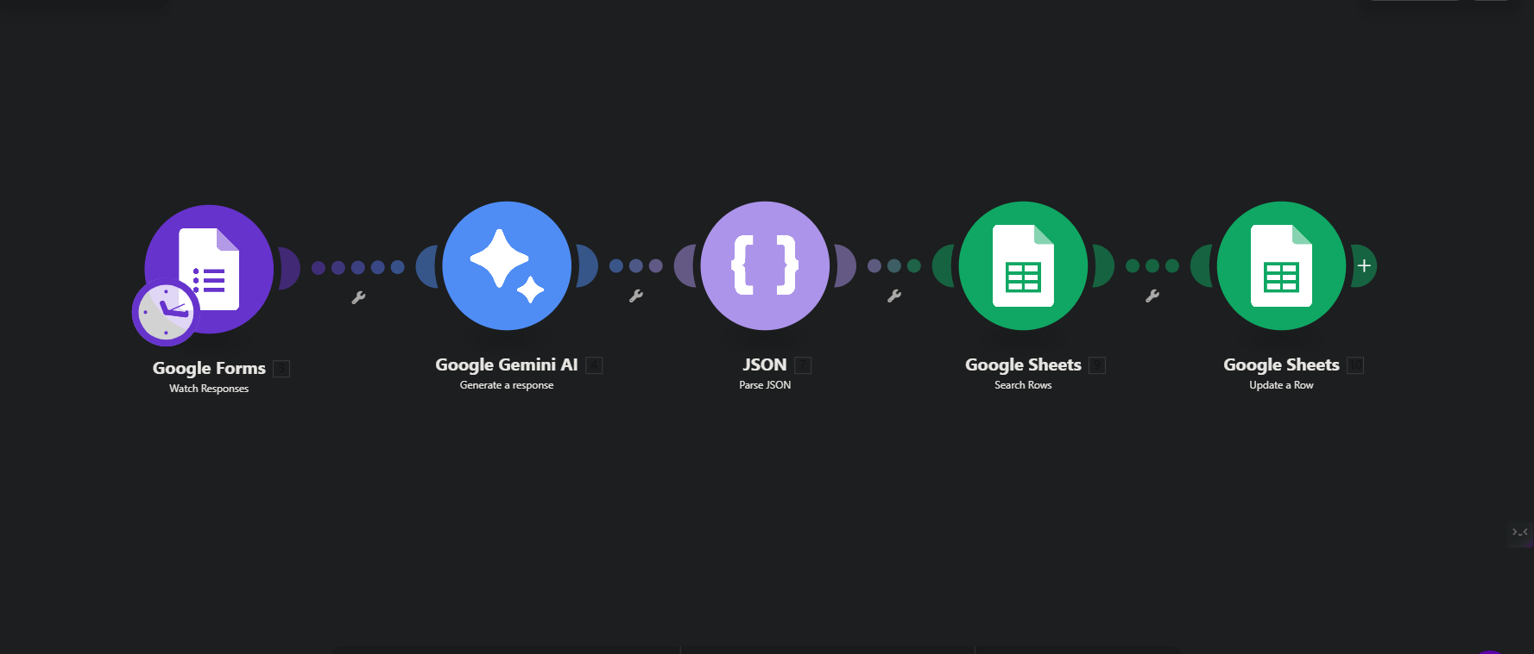
MAKE: Workflow diagram

Slide 6
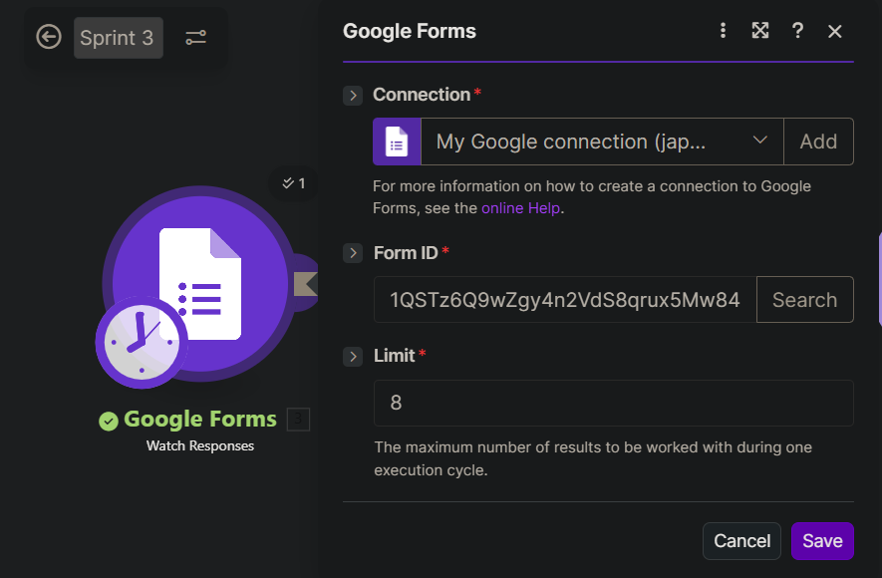
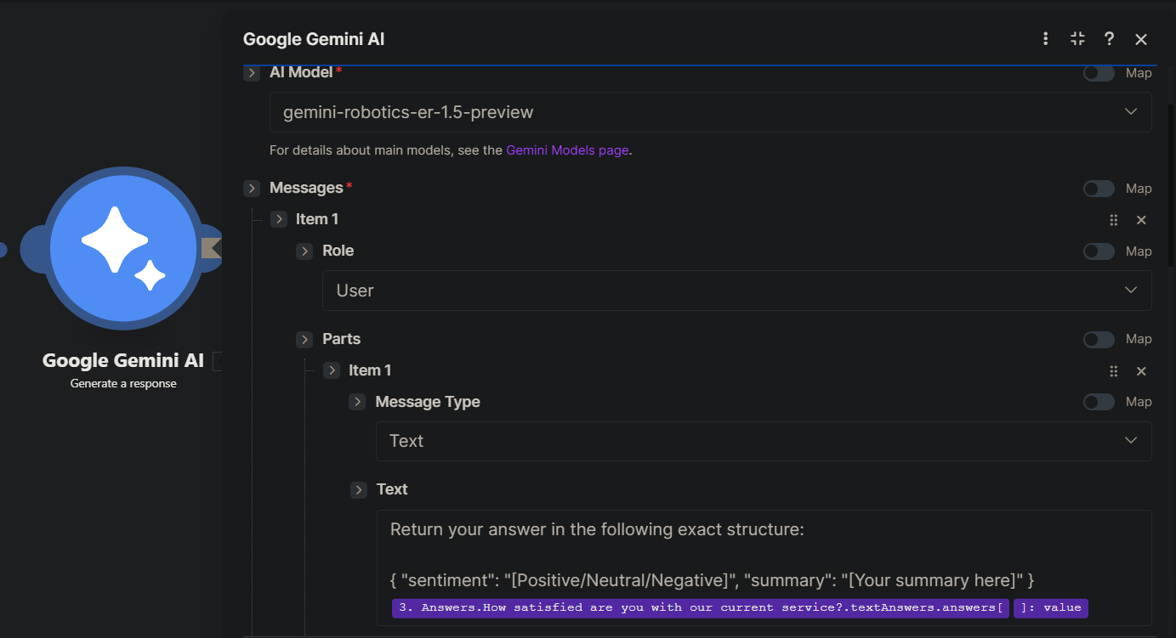
Automation workflow: MAKE

Slide 7
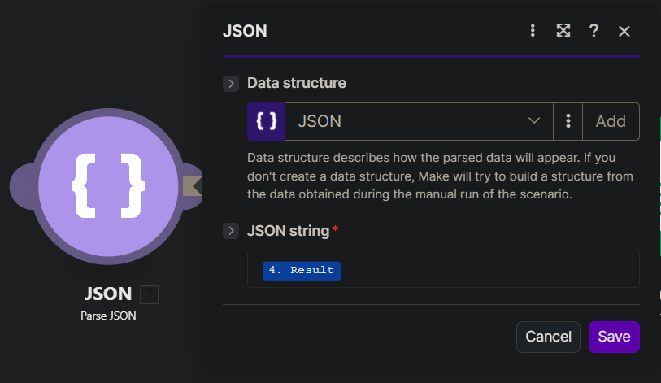
Automation workflow: MAKE

Slide 8
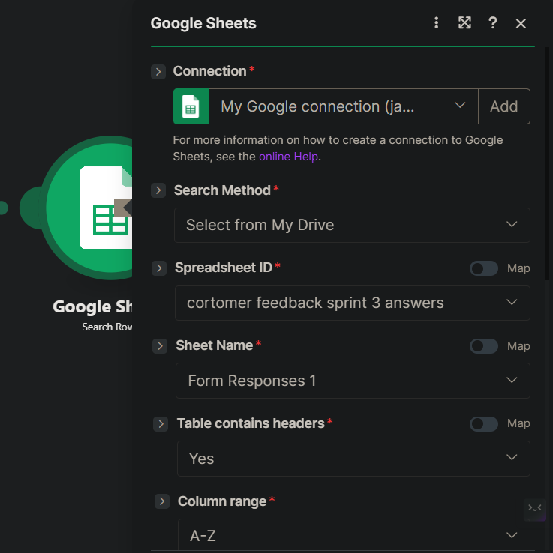
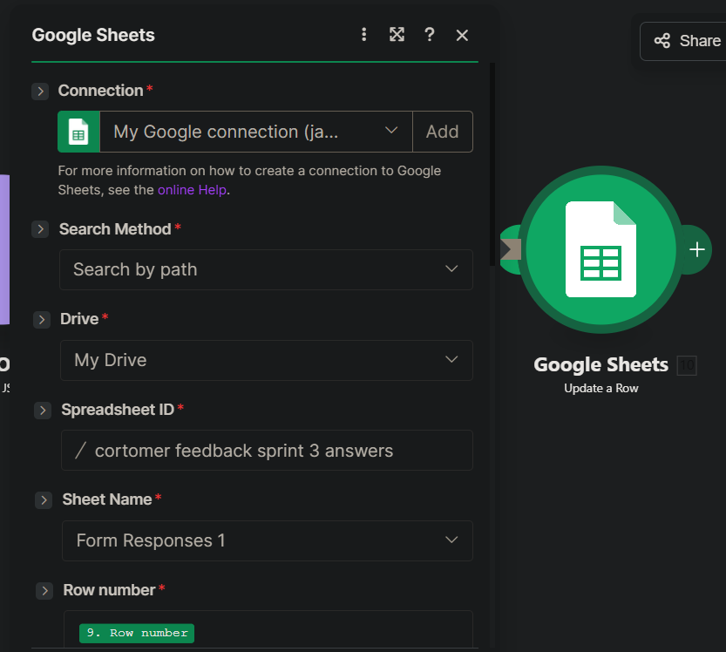
Automation workflow: MAKE

Slide 9
MAKE flow Breakdown
Through AI automation, Make seamlessly allows us to gather information, organize and categorize user inquiries 24/7 with great accuracy and efficacy.
Google forms module will “Watch” for new information sending to our AI magic
Google Gemini AI will decipher sentiment and develop short summary.
JSON module will parse and convert this data for Google sheets integration.
Finiall Google sheets will search for rows as well as update with our Customer sentiment and and summery in real time.
Benefits: Gaining time to focus on other tasks and increasing efficiency

Slide 10
Optional extras
Additional modules can always be added including, Google email, Slack notifications etc. The possibilities are endless.
Given more time, Options like these are always great additions depending on specific needs.
Google emails for example can send thank you emails and instantly notify when negative responses are loggeds ensuring swift communication.
Slack can instantly send notifications to team members and keep all departments updated strengthening the communication.
Make hosts thousands of apps that can be used to automate almost anything.

